Slide 1
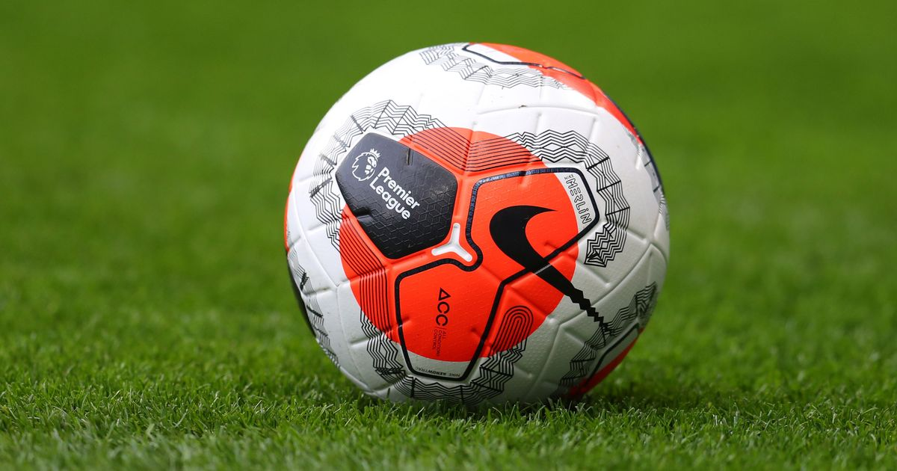
English Premier League
From 1993-94
Till 2017-18
By : Ishaan Marwah
April 2020 Cohort

Slide 2

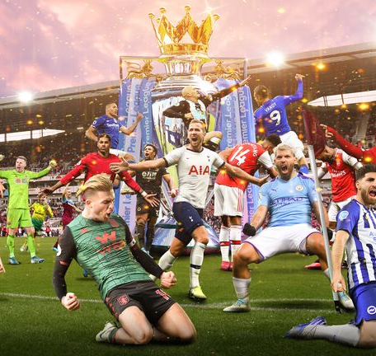
The Premier League is the top level of the English football league system. Contested by 20 clubs, it operates promotion and relegation with the English Football League. The league held its first season in 1992–93. It was composed of 22 clubs for that season. The number of clubs was reduced to 20, down from 22.
NOTE:
To change images on this slide, select a picture and delete it. Then click the Insert Picture icon
in the placeholder to insert your own image.
Try to Answer : Important Considerations to Sustain in the league (not being relegated) How can a Team improve the chances to Win the League ? Important factor to win a League - Attack or Defense? Along with - Season level Analysis for football parameters - Matches, Wins, Losses, Goals(Home and Away), Comebacks. Team level analysis for football parameters - Matches, Wins, Losses, Goals(Home and Away), Comebacks. Analysis of Team per Season - Points Table, Champions, Runner's up, Relegation, League Progress

Slide 3
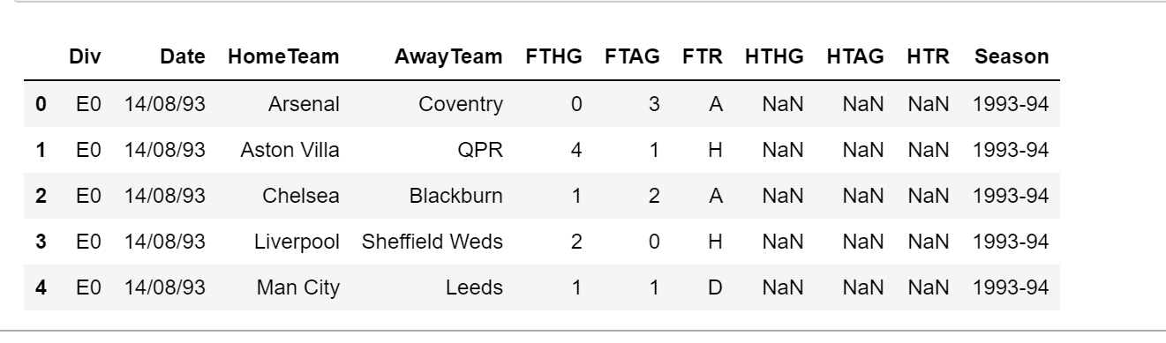
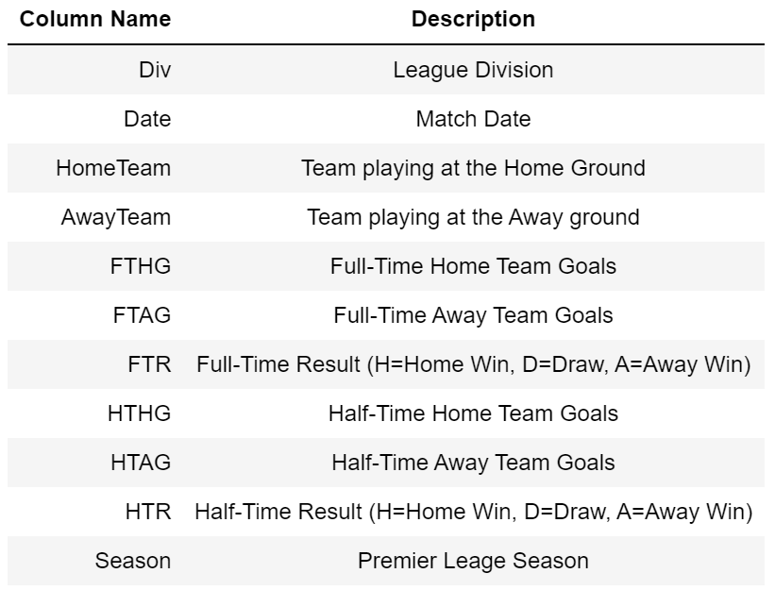
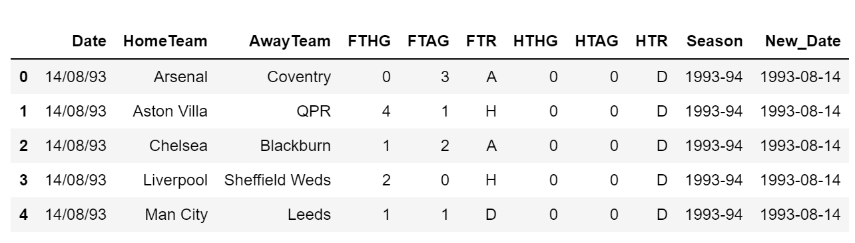
Dataset
25 years of EPL matches history with goal details and results.
Post Profiling:

Slide 4
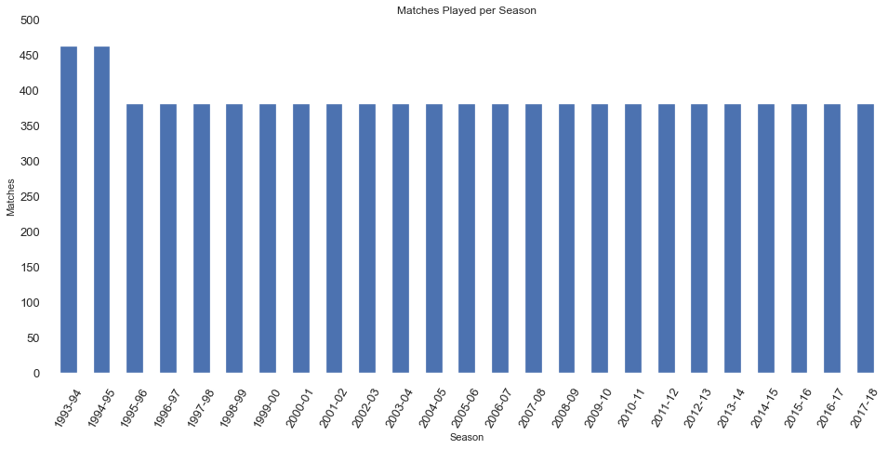
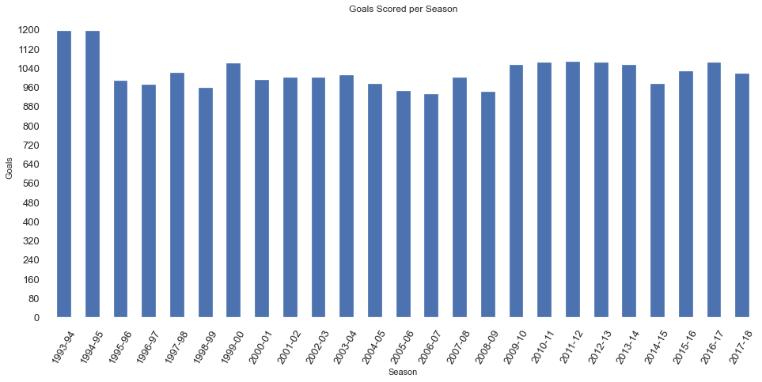
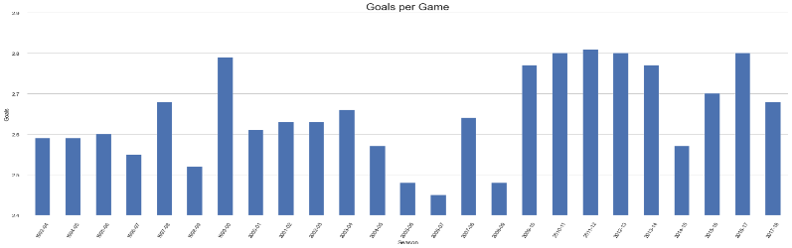
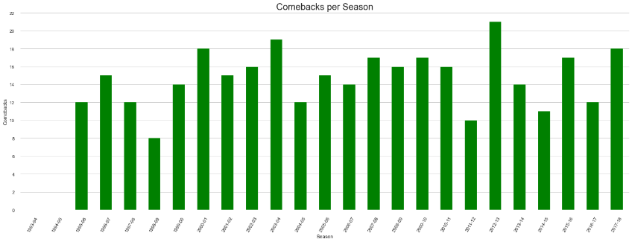
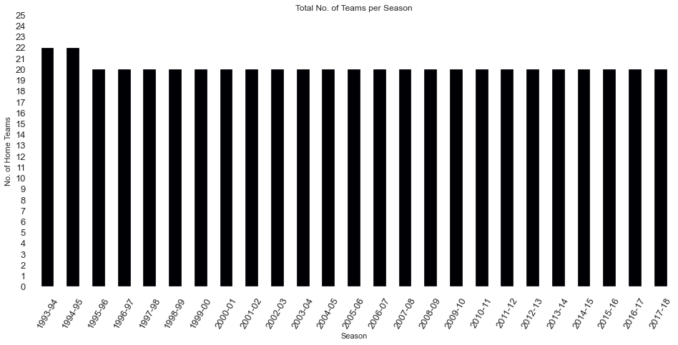
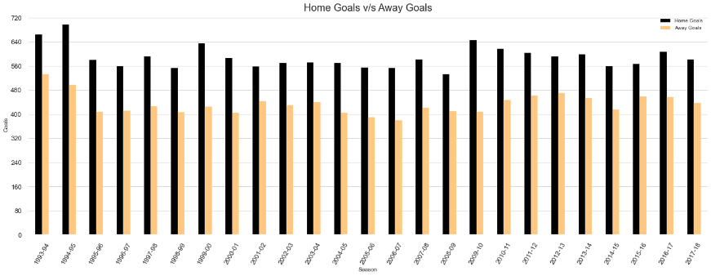
Title and Content Layout with List
Season Level Analysis
Add your first bullet point here
Add your second bullet point here
Add your third bullet point here

Slide 5





Slide 6
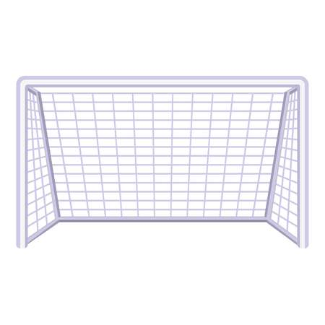
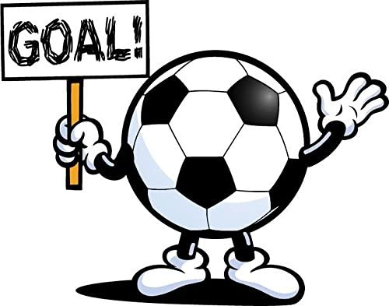
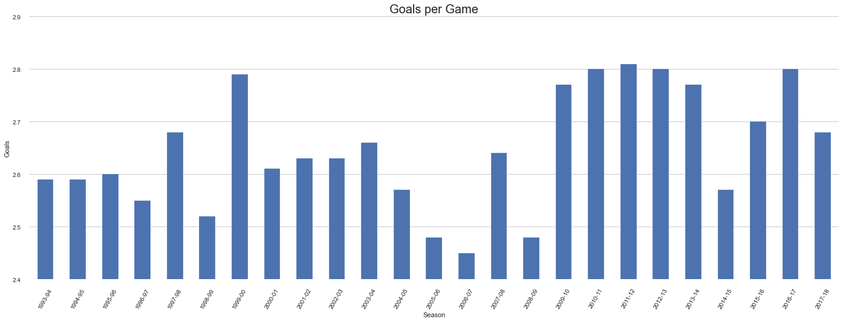

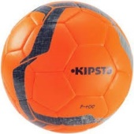

Slide 7
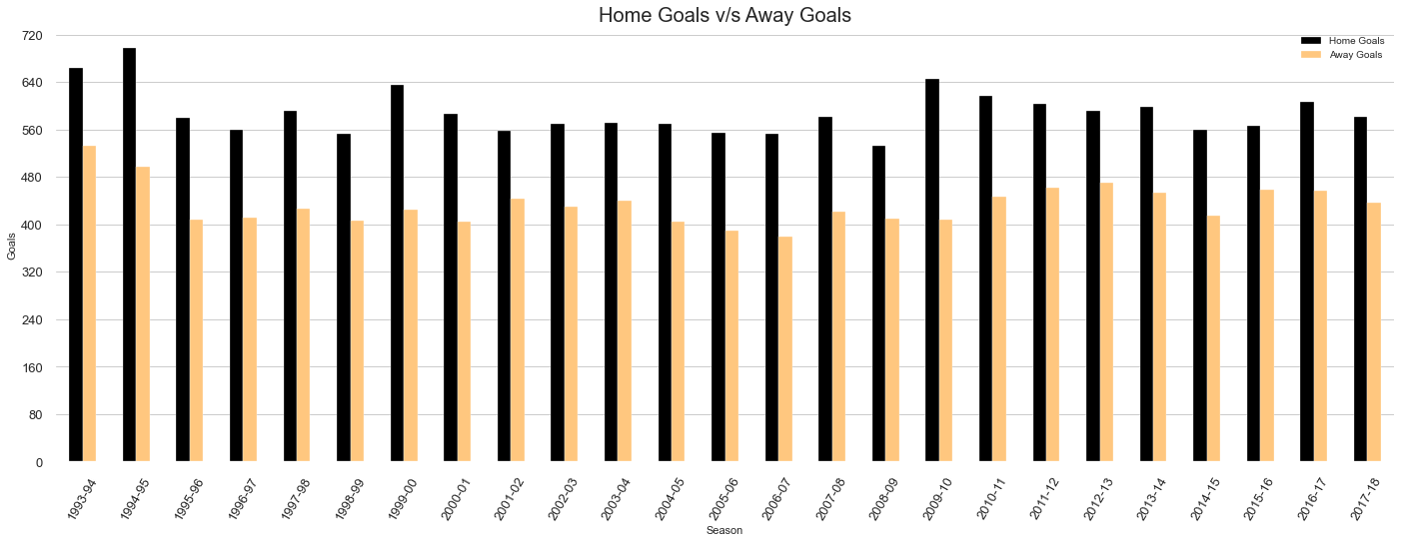
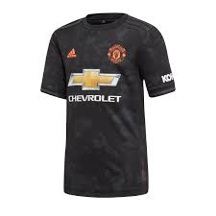
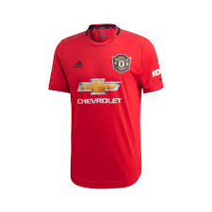

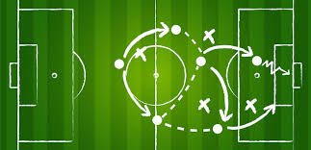

Slide 8
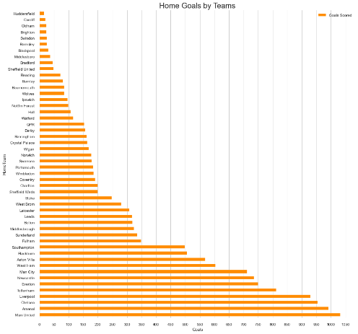
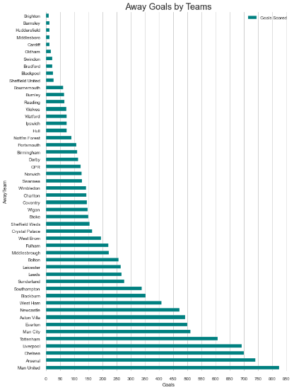
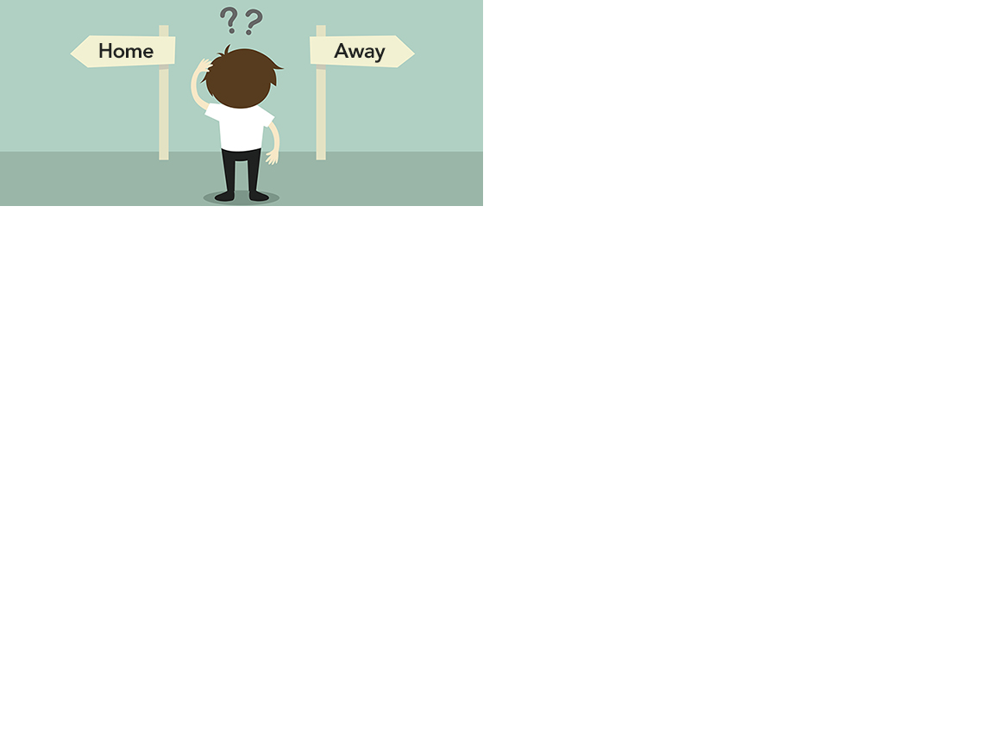
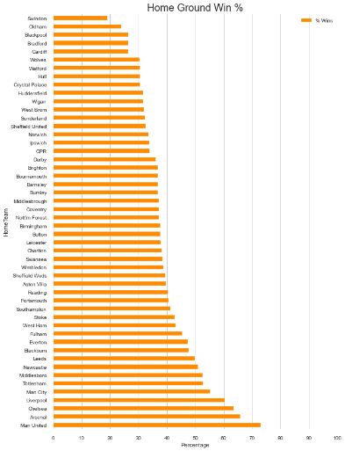
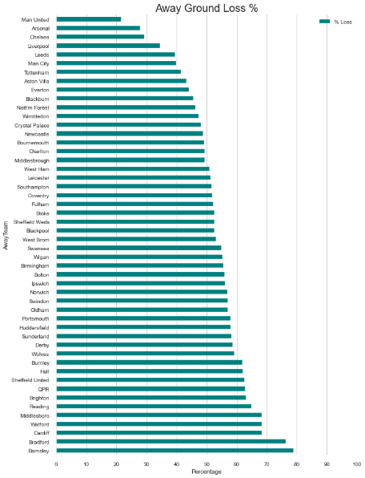
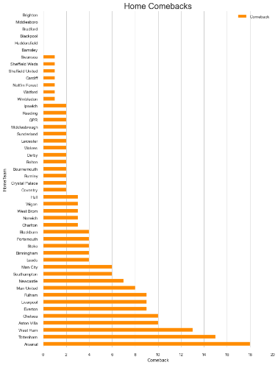
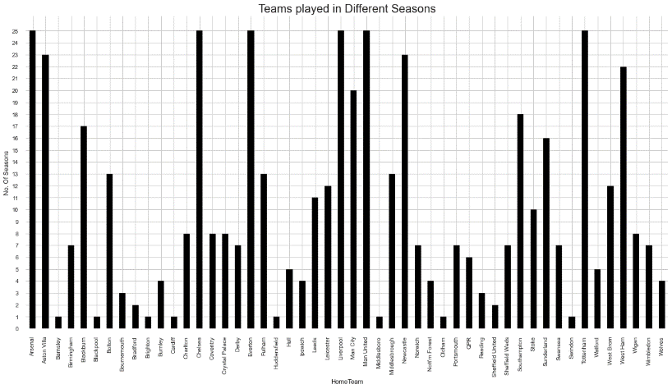
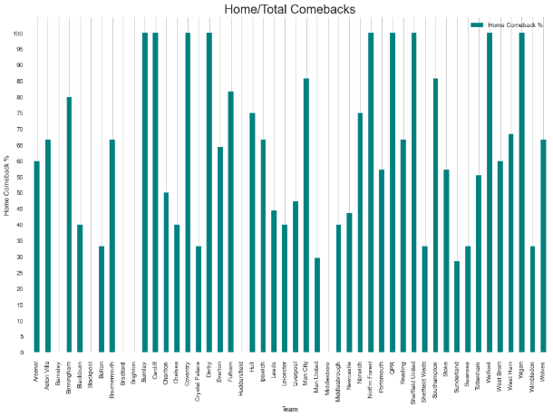
Team Level Analysis
Add your first bullet point here
Add your second bullet point here
Add your third bullet point here

Slide 9
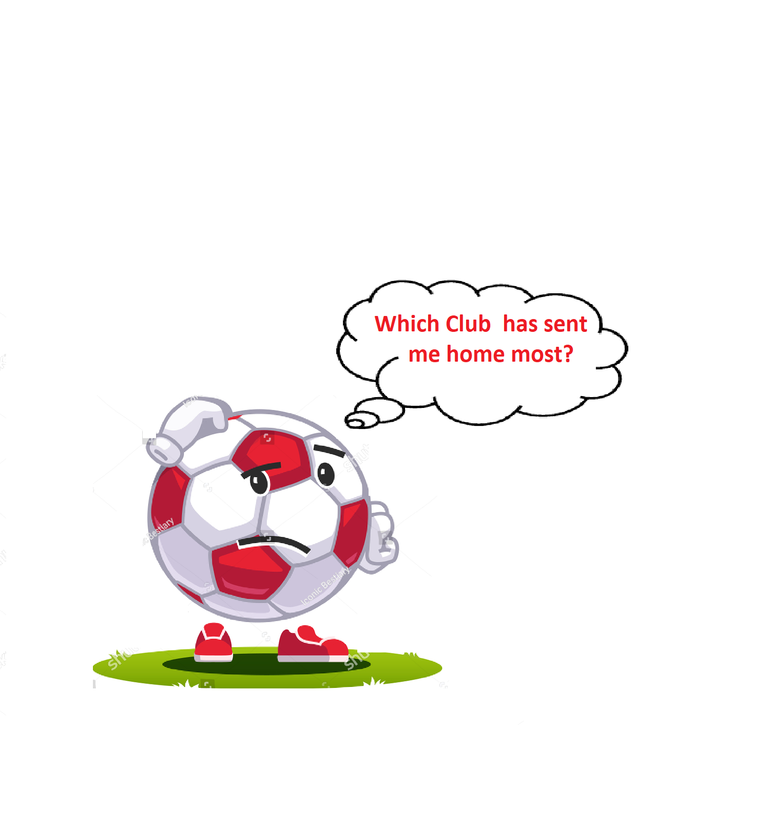
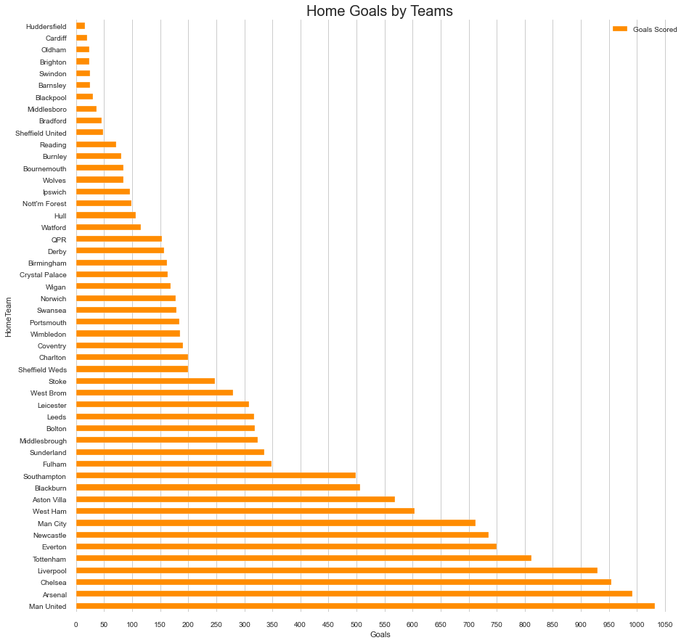
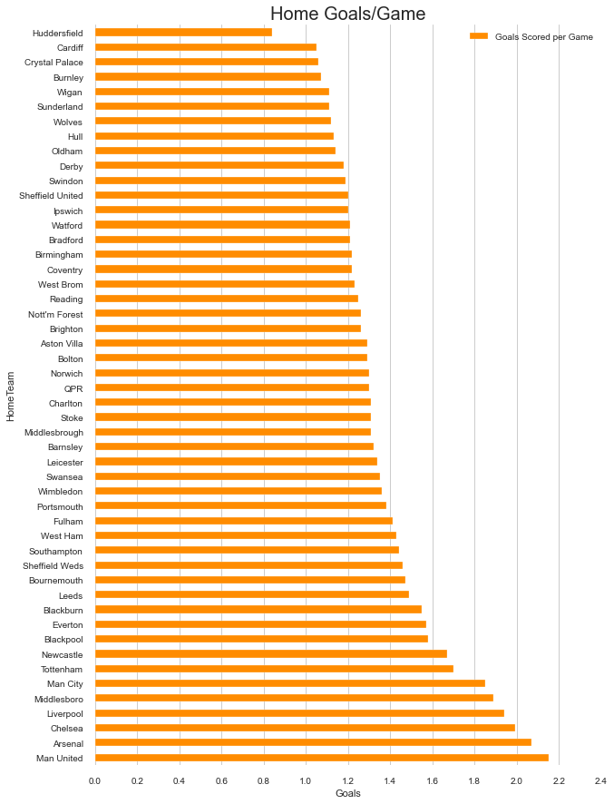

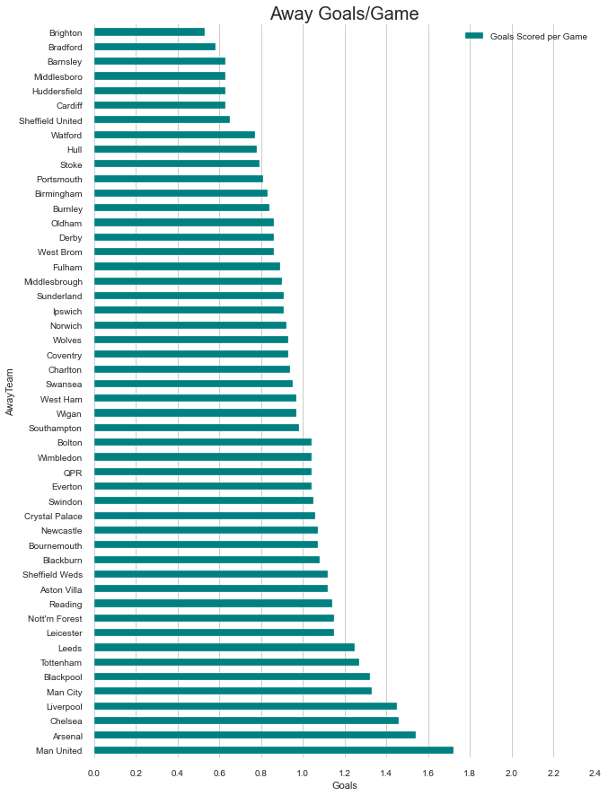

Slide 10


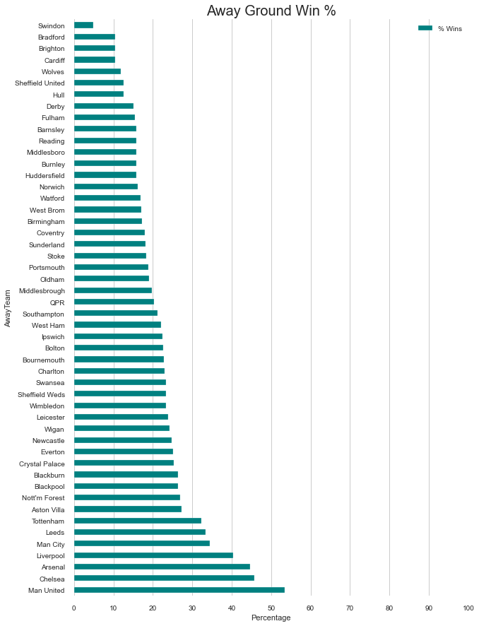


Slide 11
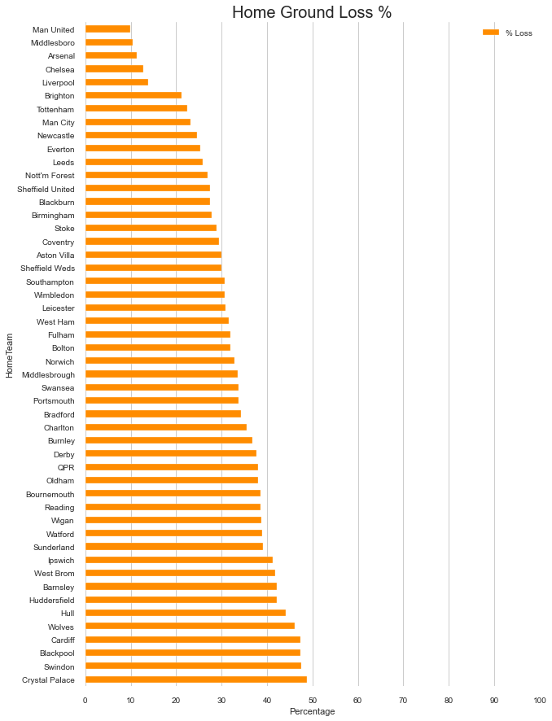
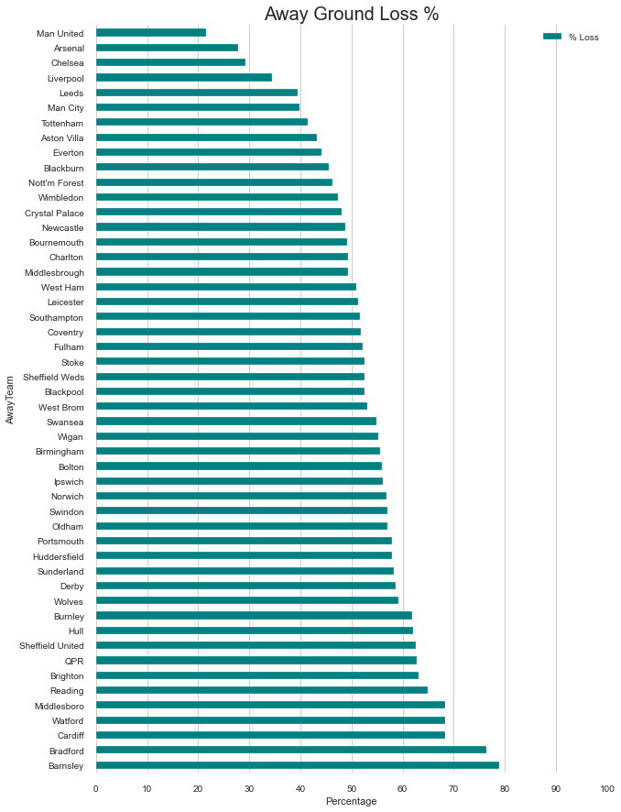
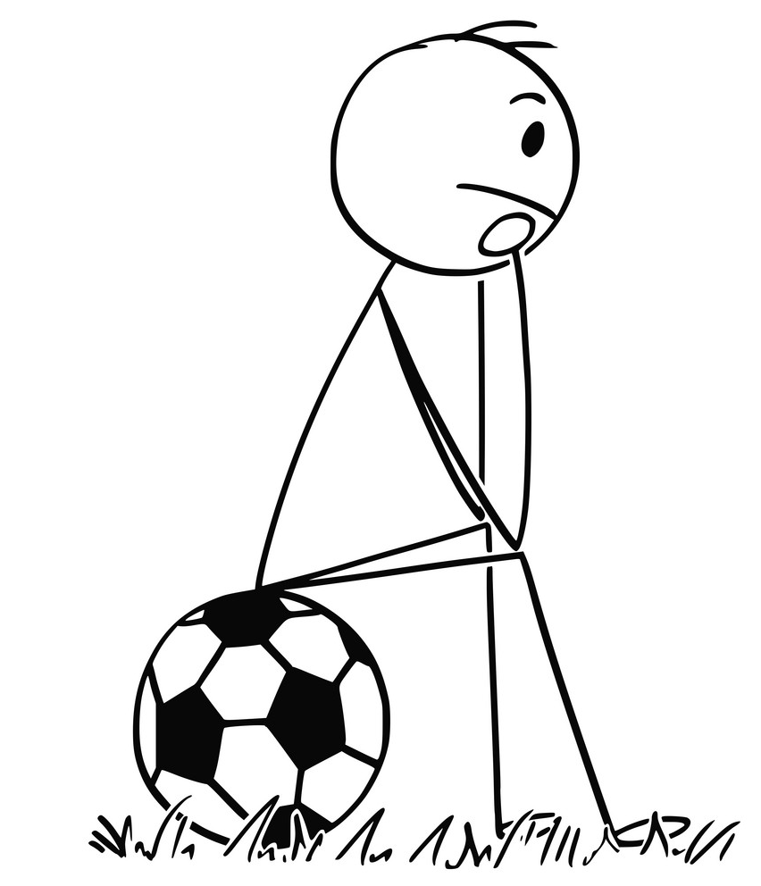


Slide 12
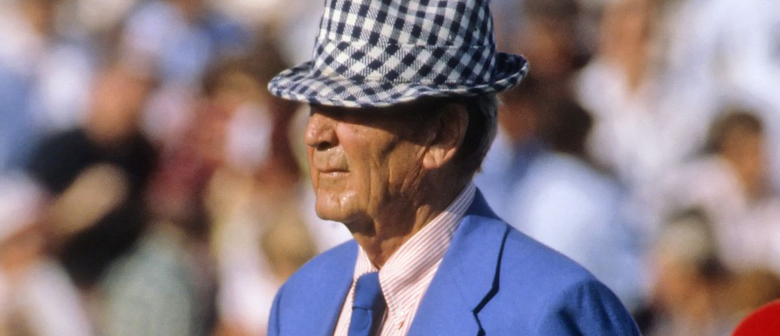
Don’t give up at half time.
Concentrate on winning the second half – Paul Bear Bryant

Slide 13

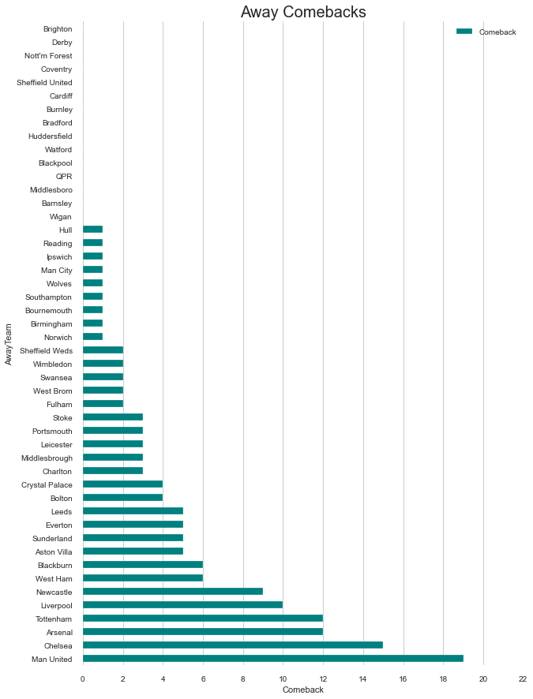

Comeback
Kings!

Slide 14





Which Teams Have Played in All Seasons?

Slide 15
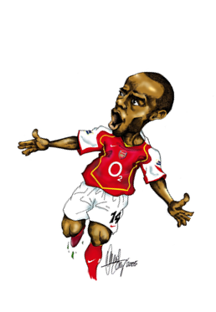


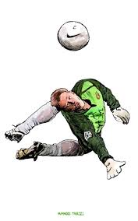

“Until you step in the game and influence the skills, you will never change the score line.”
― Israelmore Ayivor

Slide 16
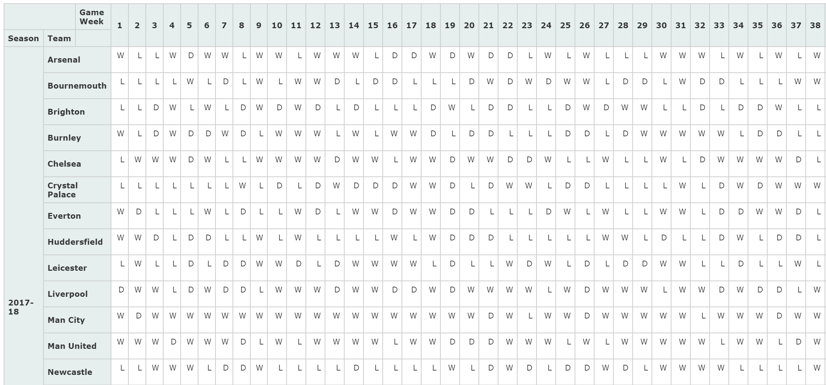

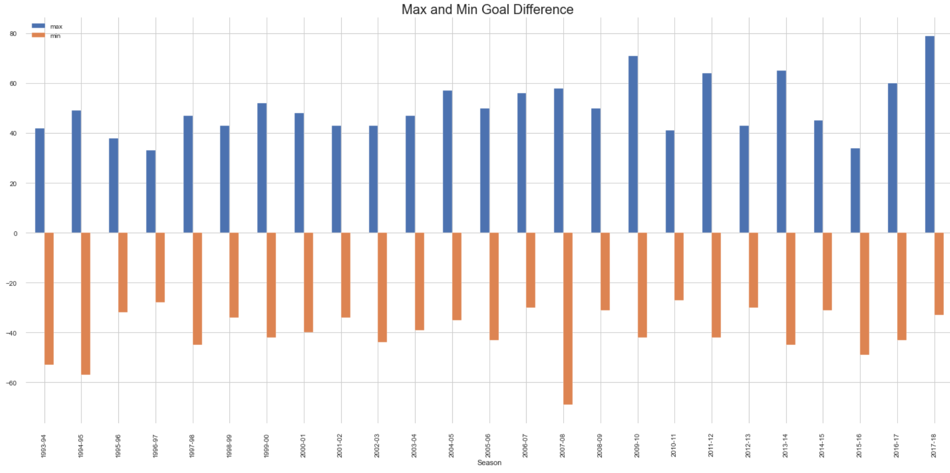
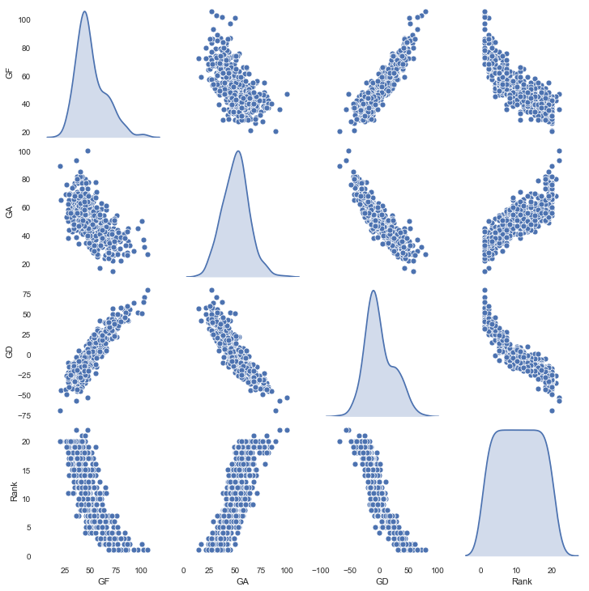
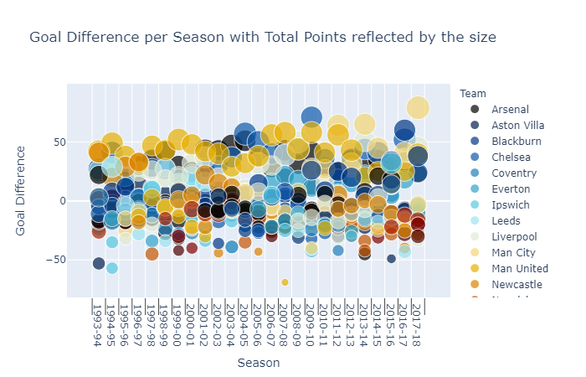
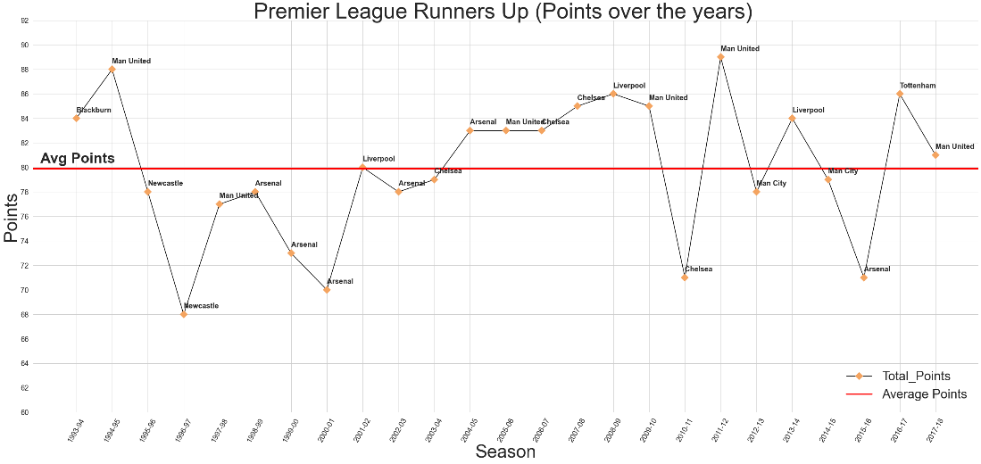
Team & Season Level Analysis

Slide 17
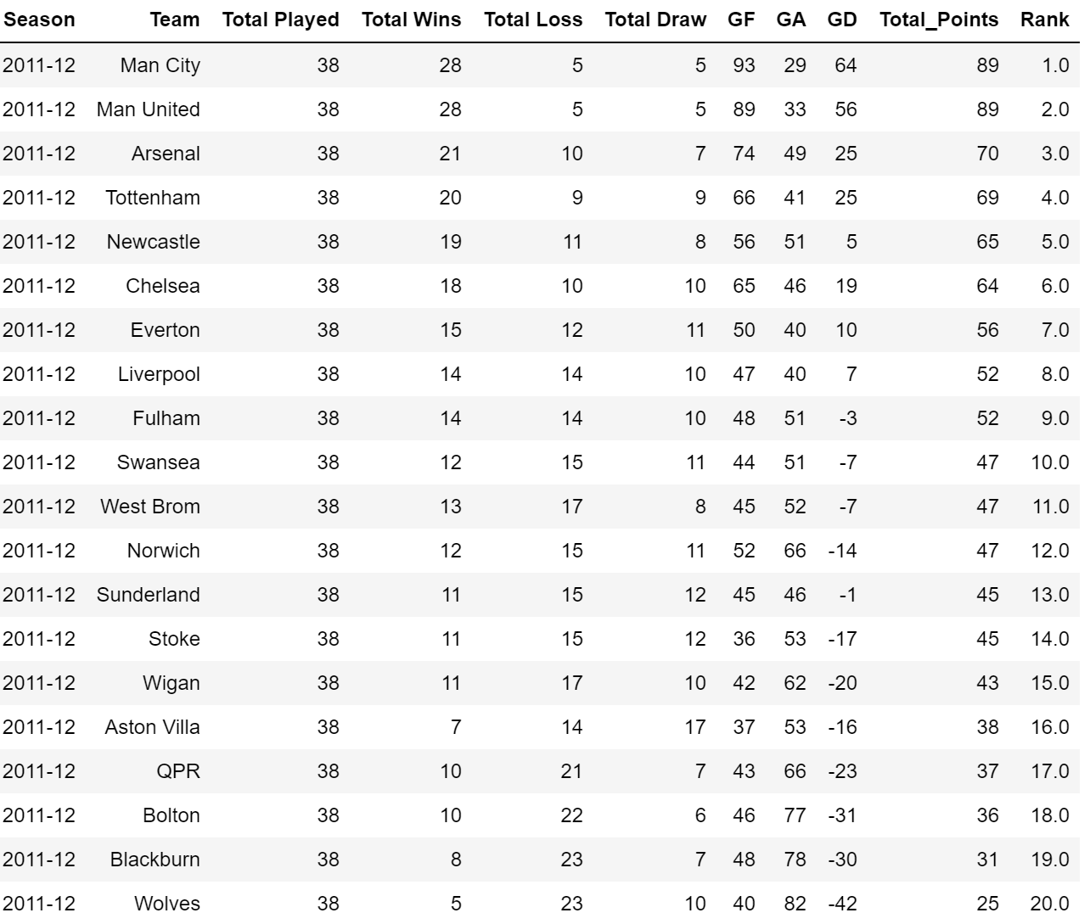
Points Table :
This table is created based on the Premier League Rules –
Win = 3 Points
Loss = 0 Point
Draw = 1 Point
The Winner is decided based on Highest Points. In case the points are same at the end of the season, the Team with larger Goal Difference (GD) is declared as the Champion team.
GF : Goals For/Scored GA: Goals Against/Conceded GD: Goal Difference [GF – GA]

Slide 18
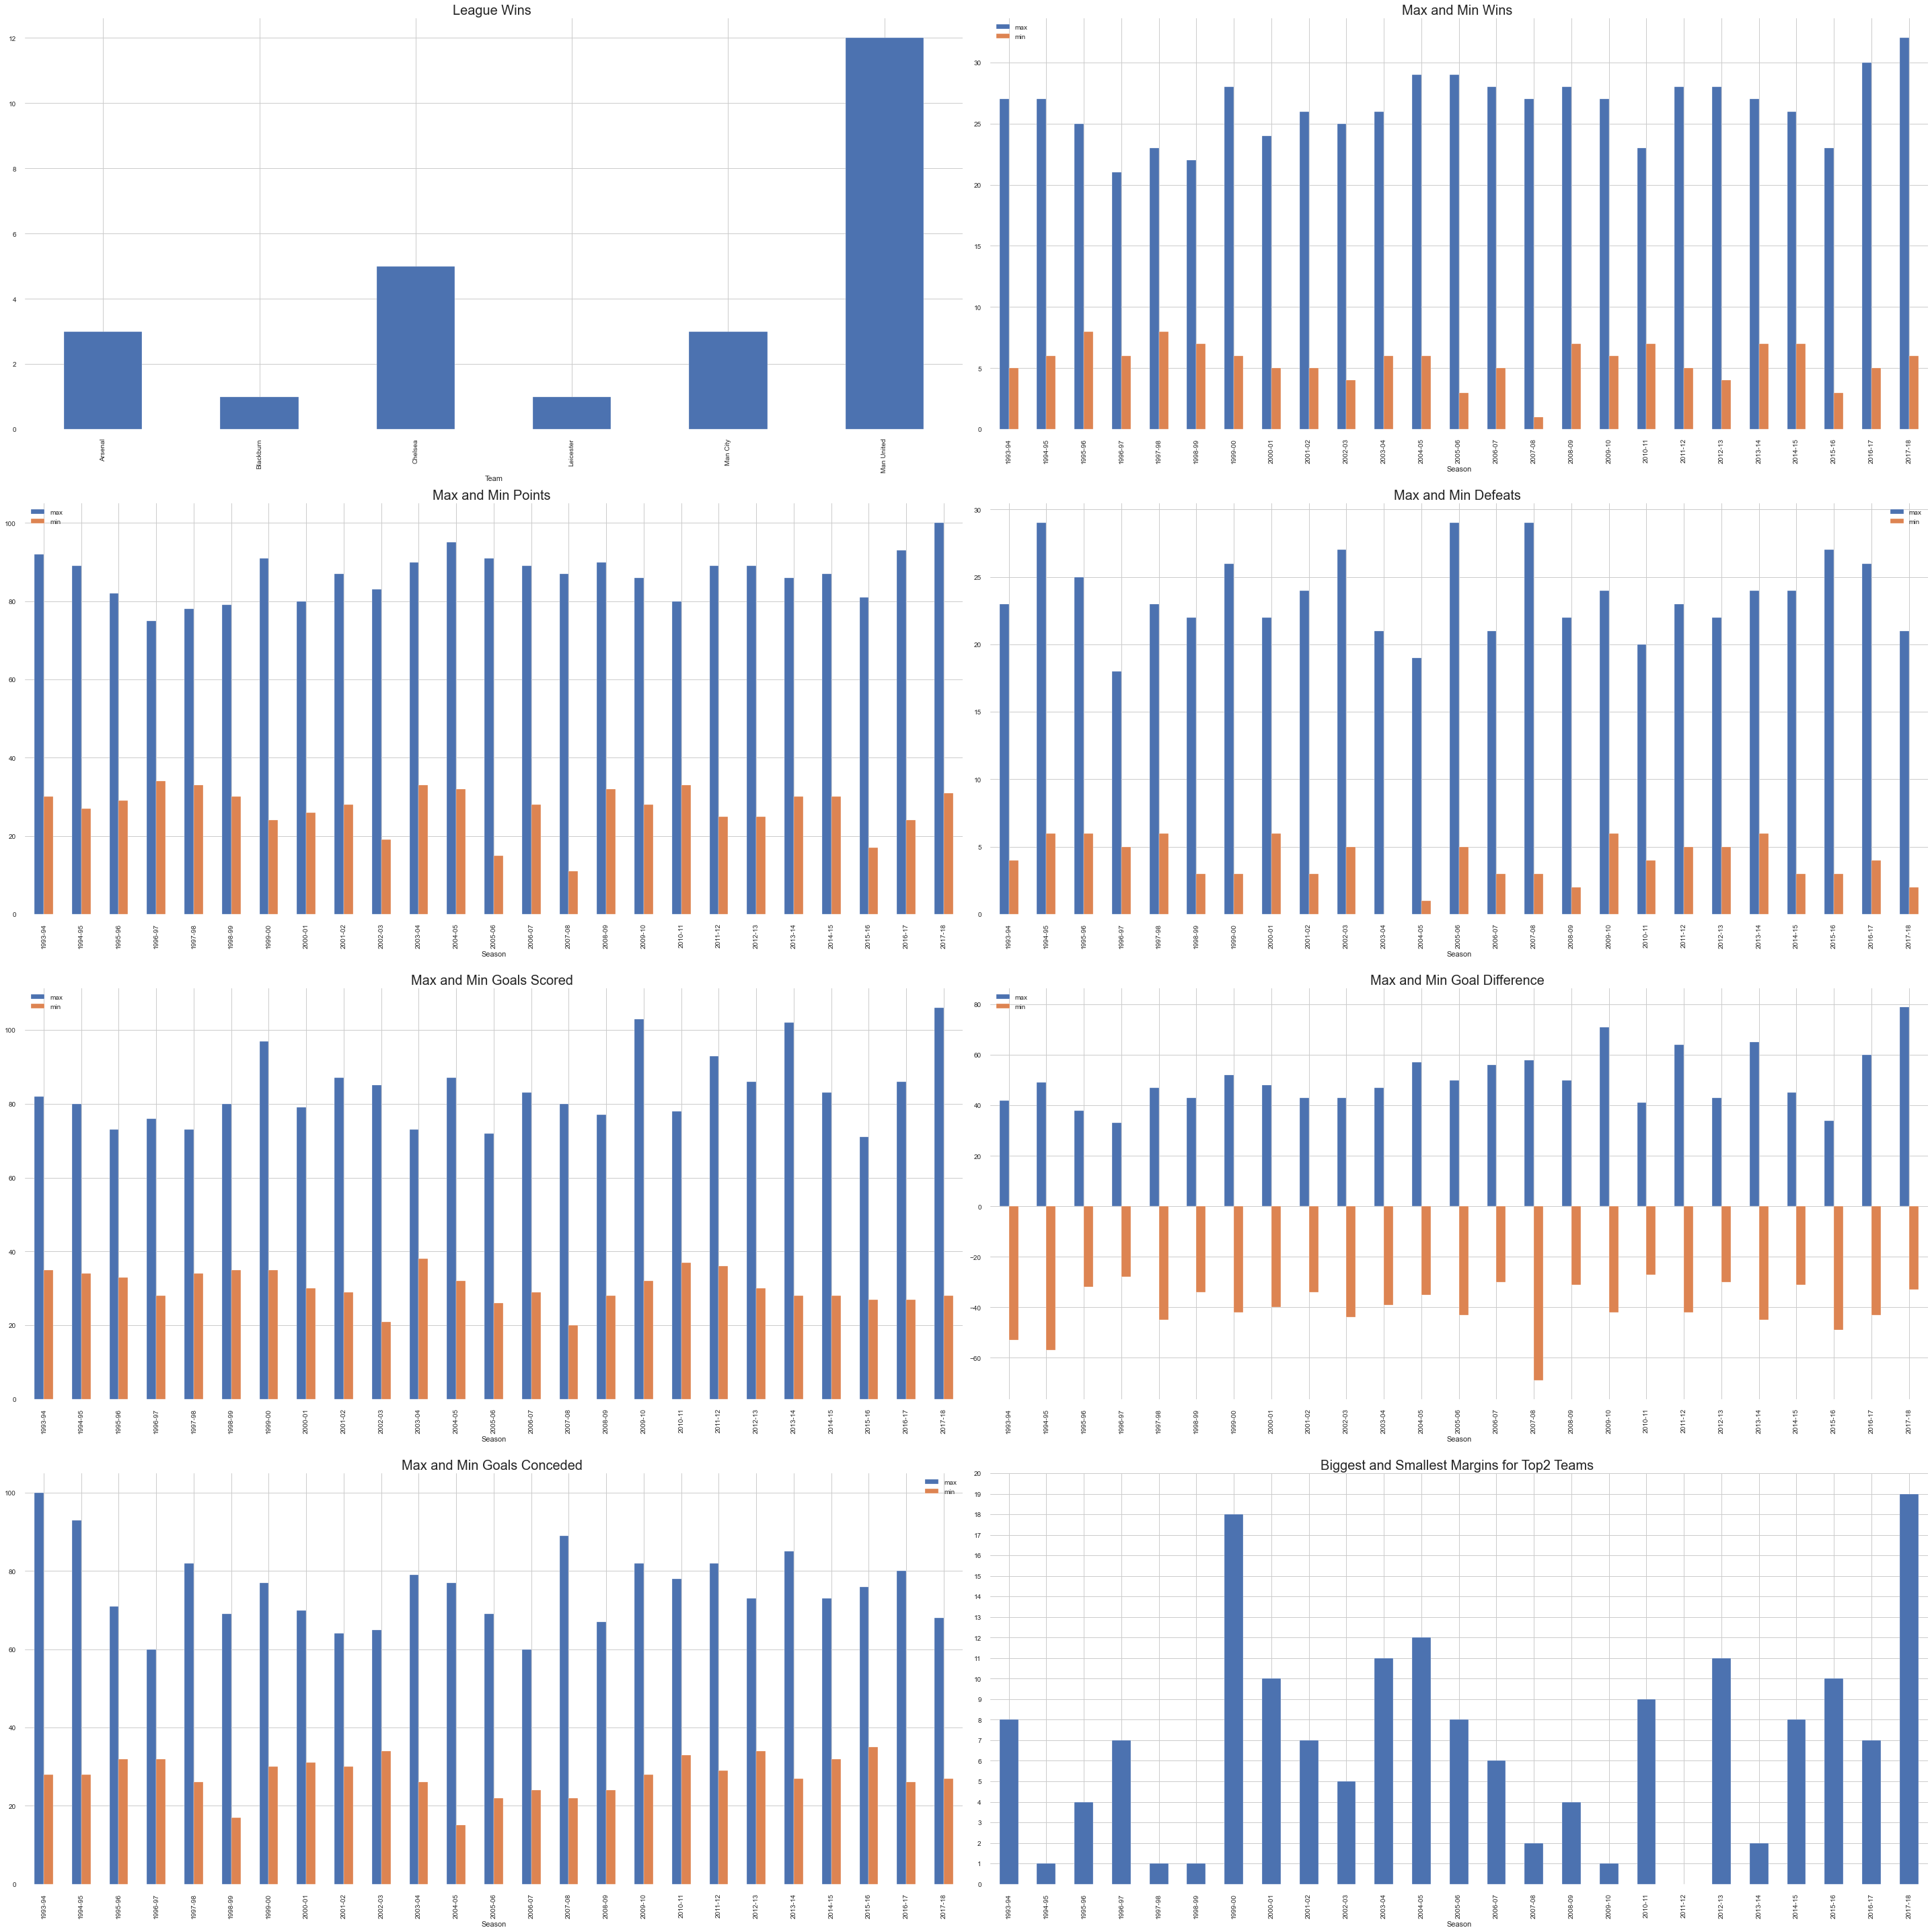
The Best and Worst in Premier League!!

Slide 19
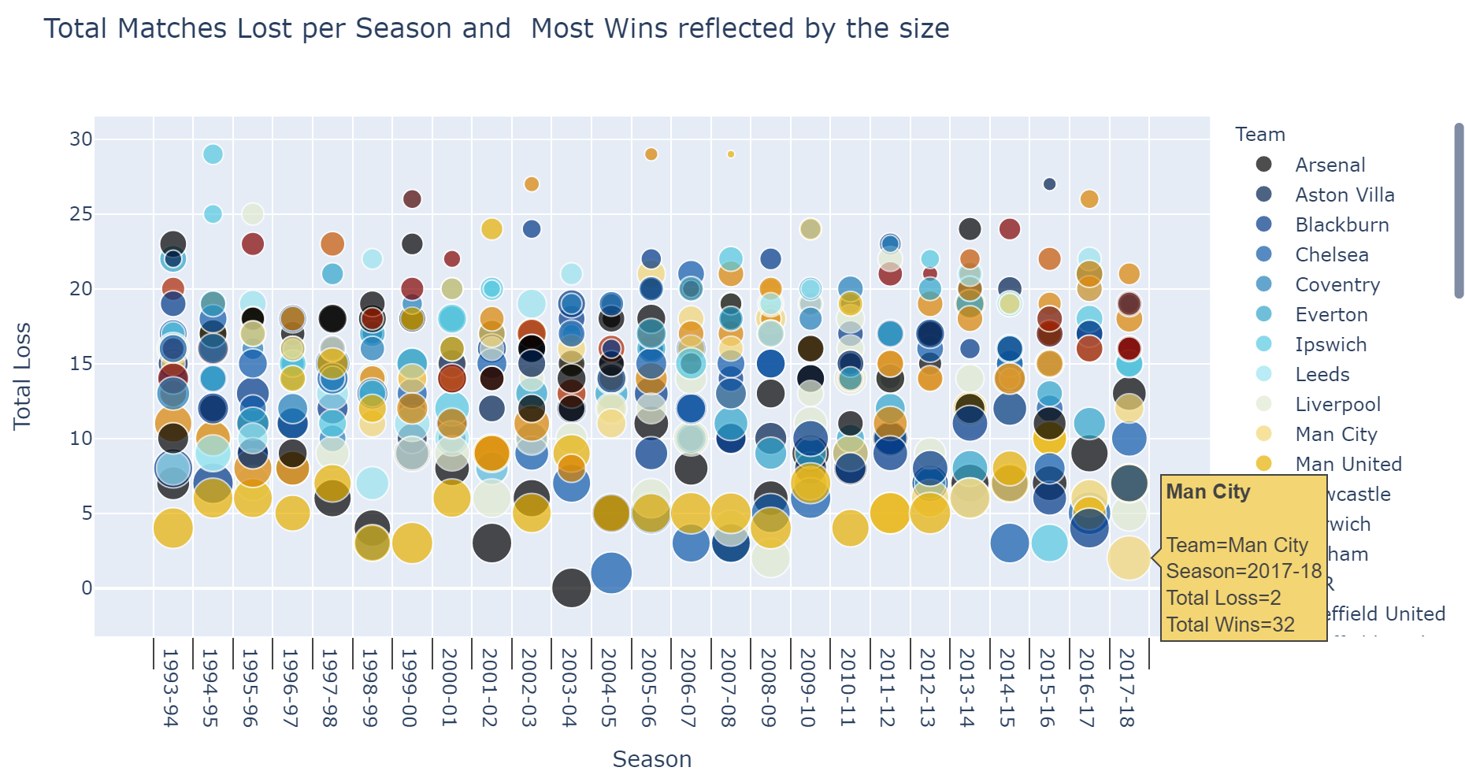
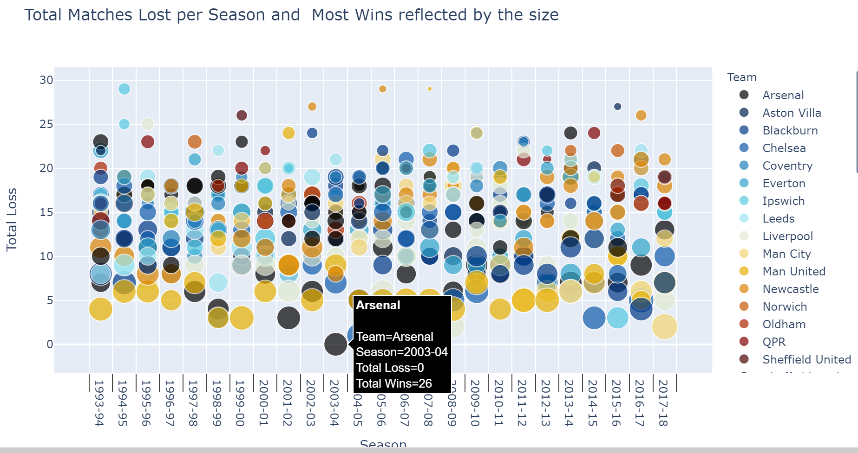
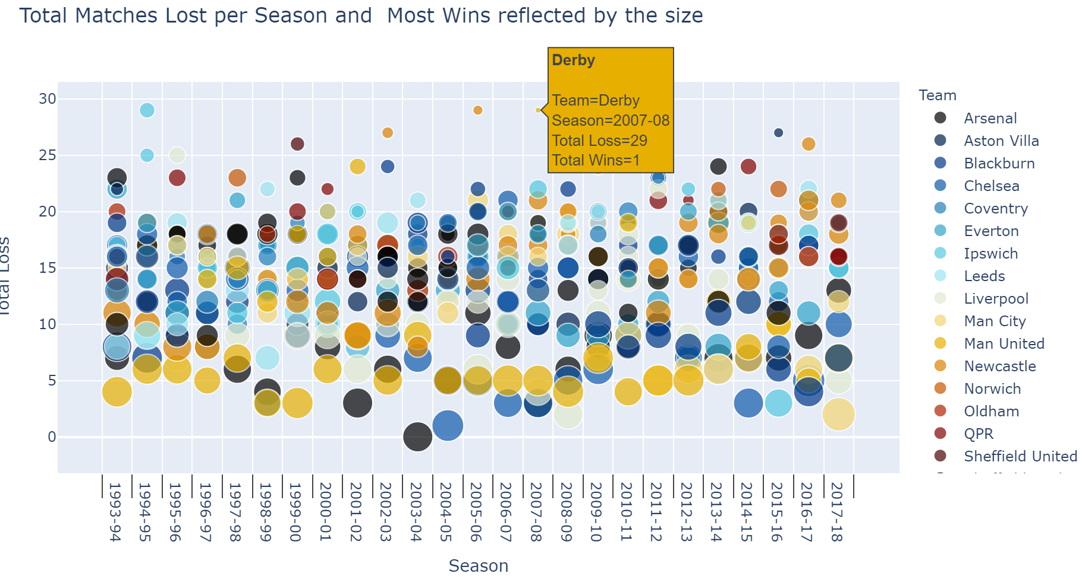
Most Matches Lost and Won in a Season
Least Defeats is in Season 2003-04 (0) -- Arsenal
Maximum Wins in a single season is in Season 2017-18 (32) -- Man City
Most Defeats in a Season is in Season 1994-95 , 2005-06 and 2007-08 (29) - Ipswich, Sunderland and Derby respectively.
Minimum Wins is in Season 2007-08 (1) -- Derby

Slide 20
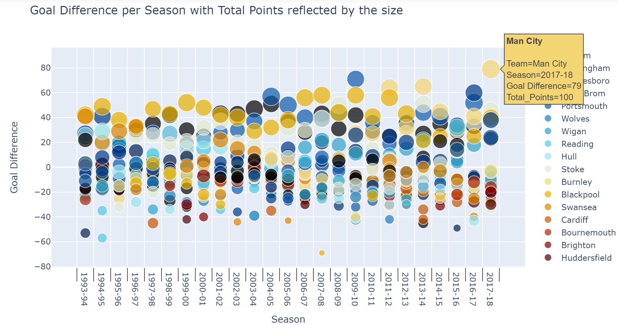

Best and Worst Goal Difference and Total Points
Maximum Points in a single season is in Season 2017-18 (100) → Manchester City
Maximum Goal Difference in a single season is in Season 2017-18 (79) → Manchester City
Minimum Goal Difference is in Season 2007-08 (-69) → Derby
Minimum Points is in Season 2007-08 (11) → Derby

Slide 21




Most/Least Goals Scored and Goals Conceded
Maximum Goals in a single season is in Season 2017-18 (106) → Manchester City
Minimum Goals is in Season 2007-08 (20) → Derby
Maximum Goals Conceded in a single season is in Season 1993-94 (100) → Swindon
Minimum Goals Conceded is in Season 2004 -05 (15) → Chelsea

Slide 22


How did a Team progress in a Season?
Weekly Form:
Weekly Points:

Slide 23



Weekly Rank:
Weekly Result with Points:
Select Season
Select Team

Slide 24


Slide 25


What can a Team do to improve their chance to Win the League?

Slide 26


What can a Team do to improve their chance to Sustain in the League and avoid Relegation?

Slide 27
How does Goals affect Ranking of a Team?
There is a strong co-relation between Goals Scored, Goals Conceded, Goal Difference and Ranking of a Team in the league.
More Goals Scored → Better Ranking
Less Goals Conceded → Better Ranking
High Goal Difference → Better Ranking
GF : Goals For/Scored GA: Goals Against/Conceded GD: Goal Difference [GF – GA]

Slide 28

What wins more titles - Attack or Defense?

Slide 29
Conclusions :
First 2 seasons of Premier League had 22 teams which was reduced to 20 teams from the 1995-96 season. As per our analysis, it looks like the Quality of games was low in the initial seasons and may have triggered the move to reduce the number of teams. Another possible reason to reduce teams could be number of games(days) in a season as there is a break needed for International Games as well in between.
All seasons have more Home Goals than Away goals hinting towards possible Home Ground Advantage for goal scoring.
Manchester United have emerged as the most consistent and successful club in the Premier League History in terms of Goals Scored, Wins [Home(73%) and Away(55%)], Draws, Loss [Home(10%) and Away(22%)], Goals Conceded and Titles Won (12).
Arsenal, Chelsea, Everton, Liverpool, Man United and Tottenham have played in all 25 Seasons.
A Team with Best Goal Difference in a Season Won the Title 68% of the times.
In terms of Half Time Comebacks, Arsenal and Manchester United are the teams leading at Home and Away with 18 and 19 comebacks, respectively.
We also had a look into the Best and Worst Stats of the Premier League.

Slide 30
Actionable Insights :
Statistically, In order to Win a League, on an average a team should score 81 Goals and secure a total of 87 Points.
Statistically, in order to Sustain in the League, on an average a team should score 39 Goals and secure a total of 36 Points.
As a Team with Best Goal Difference in a Season Won the Title 68% of the times, a Team should consider Defense as an important measure to win a league and not only attack or Goal Scoring. This attribute can be used by the teams while Trading Players and during team building phase
As we have seen throughout our analysis that various features like wins and losses, goals scored and goals conceded hints towards a Home Ground Advantage. Possible reasons for the same are Home Crowd creating pressure on the Away Teams behaving as a nonplaying 12th man and also acquaintance with "Ground Size and Pitch" with the daily practices. While crowds is something that is not controllable, there could possibly be a standardization done with ground sizes and Pitches to mitigate the advantage.

Slide 31




Thanks For Watching
Please share your queries and feedback -
Ishaan Marwah
ishum17@gmail.com

